Slide 1
F# Succinct, Expressive, Efficient Functional Programming for .NET
The F# Team
Microsoft Developer Division, Redmond
Microsoft Research, Cambridge

Slide 2
Topics
What is F# about?
Some Simple F# Programming
A Taste of Parallel/Reactive with F#

Slide 3
F#: Combining Paradigms
Functional
Strong Typing
Succinct
Type Inference
Data Types and Patterns
1st Class Functions
Meta-Programming
Objects
.NET OO Model
Interoperable
Compact type-inferred classes
.NET
Visual Studio
Libraries
Tools
Concurrency
LINQ
Tools
F# Compiler
F# Interactive
Visual Studio Integration
Math/Plot Bindings
Lex and Yacc

Slide 4
F#: The Combination Counts!
Statically Typed
Succinct
F#
Libraries
Explorative
Interoperable
Efficient
Scalable

Slide 5
F#: Combining Paradigms
I've been coding in F# lately, for a production task. F# allows you to move smoothly in your programming style... I start with pure functional code, shift slightly towards an object-oriented style, and in production code, I sometimes have to do some imperative programming.
I can start with a pure idea, and still finish my project with realistic code. You're never disappointed in any phase of the project!
Julien Laugel, Chief Software Architect, www.eurostocks.com

Slide 6
F#: Influences
OCaml
C#/.NET
F#
Similar core
language
Similar object
model

Slide 7
The Path to Mastering F#
Topic | Covered Today
Scoping and “let” | ✓
Tuples | ✓
Pattern Matching | ✓
Working with Functions | ✓
Sequences, Lists, Options | ✓
Records and Unions | ✓
Basic Imperative Programming | ✓
Basic Objects and Types | ✓
The F# Libraries | ✗
Advanced Functional/Imperative | ✗
Advanced Functional/OO | ✗
Language Oriented Programming | ✓ (later)
Parallel and Asynchronous | ✓ (later)

Slide 8
Quick Tour
Comments
// comment
(* comment *)
/// XML doc comment
let x = 1

Slide 9
Quick Tour
Overloaded Arithmetic
x + y Addition
x - y Subtraction
x * y Multiplication
x / y Division
x % y Remainder/modulus
-x Unary negation
Booleans
not expr Boolean negation
expr && expr Boolean “and”
expr || expr Boolean “or”

Slide 10
Quick Tour: Types
Basic Types and Literals
sbyte = System.SByte 76y
byte = System.Byte 76uy
int16 = System.Int16 76s
uint16 = System.UInt16 76us
int32 = System.Int32 76
uint32 = System.UInt32 76u
int64 = System.Int64 76L
uint64 = System.UInt64 76UL
string = System.String "abc", @"c:\etc"
single = System.Single 3.14f
double = System.Double 3.14, 3.2e5
char = System.Char '7'
nativeint = System.IntPtr 76n
unativeint = System.UIntPtr 76un
bool = System.Boolean true, false
unit = Microsoft.FSharp.Core.Unit ()
Basic Type Abbreviations
int8 = sbyte
uint8 = byte
int = int32
float32 = single
float = double

Slide 11
Orthogonal & Unified Constructs
Type inference. The safety of C# with the succinctness of a scripting language
Let “let” simplify your life…
Bind a static value
let data = (1,2,3)
let f(a,b,c) =
let sum = a + b + c
let g(x) = sum + x*x
g(a), g(b), g(c)
Bind a static function
Bind a local value
Bind a local function

Slide 12
Demo: Let’s WebCrawl…

Slide 13
Orthogonal & Unified Constructs
Functions: like delegates + unified and simple
One simple
mechanism,
many
uses
Anonymous
Function value
(fun x -> x + 1)
let f(x) = x + 1
(f,f)
val f : int -> int
predicate = 'a -> bool
send = 'a -> unit
Declare a
function value
threadStart = unit -> unit
A pair
of function values
comparer = 'a -> 'a -> int
hasher = 'a -> int
A function type
equality = 'a -> 'a -> bool

Slide 14
F# - Functional
let f x = x+1
let pair x = (x,x)
let fst (x,y) = x
let data = (Some [1;2;3], Some [4;5;6])
match data with
| Some(nums1), Some(nums2) -> nums1 @ nums2
| None, Some(nums) -> nums
| Some(nums), None -> nums
| None, None -> failwith "missing!"

Slide 15
F# - Functional
List.map Seq.fold
Array.filter Lazy.force Set.union
Map LazyList Events Async...
[ 0..1000 ]
[ for x in 0..10 -> (x, x * x) ]
[| for x in 0..10 -> (x, x * x) |]
seq { for x in 0..10 -> (x, x * x) }
Range
Expressions
List via query
Array via query
IEnumerable
via query

Slide 16

F# - Functional + Queries
SQL <@ { for customer in db.Customers do
for employee in db.Employees do
if customer.Name = employee.Name then
yield (customer.Name, employee.Address) } @>
SQL : Expr<seq<'a>> -> seq<'a>
LINQ SQLMetal
SQL Database

Slide 17
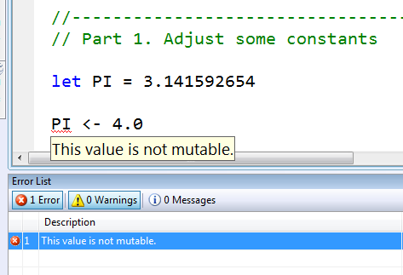
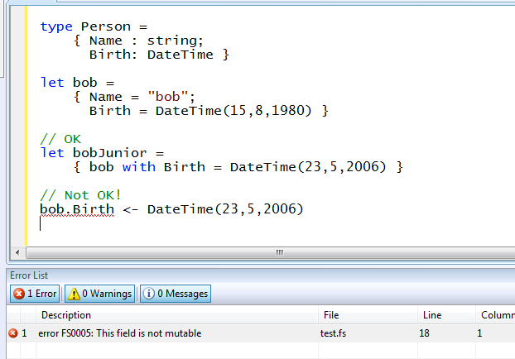
Immutability the norm…
Data is immutable by default
Values may not be changed
✓ Copy & Update
✗ Not Mutate

Slide 18
In Praise of Immutability
Immutable objects can be relied upon
Immutable objects can transfer between threads
Immutable objects can be aliased safely
Immutable objects lead to (different) optimization opportunities

Slide 19
F# - Imperative + Functional
Using .NET collections
open System.Collections.Generic
let dict = new Dictionary<int,string>(1000)
dict.[17] <- "Seventeen"
dict.[1000] <- "One Grand"
for (KeyValue(k,v)) in dict do
printfn "key = %d, value = %s" k v

Slide 20
F# - Imperative + Functional
“use” =
C# “using”
open System.IO
open System.Collections.Generic
let readAllLines(file) =
use inp = File.OpenText file
let res = new List<_>()
while not(inp.EndOfStream) do
res.Add(inp.ReadLine())
res.ToArray()

Slide 21
F# - Sequences
Sequence Expressions and
On -demand I/O
open System.IO
let rec allFiles(dir) =
seq
{ for file in Directory.GetFiles(dir) do
yield file
for sub in Directory.GetDirectories(dir) do
yield! allFiles(sub) }
allFiles(@"C:\WINDOWS") |> Seq.take 100 |> show

Slide 22
Weakly Typed? Slow?
//F#
#light
open System
let a = 2
Console.WriteLine(a)
//C#
using System;
namespace ConsoleApplication1
{
class Program
{
static int a()
{
return 2;
}
static void Main(string[] args)
{
Console.WriteLine(a);
}
}
}
Looks Weakly typed?
Maybe Dynamic?
Notes:
But why does F# omit any type information? Is it not type safe? Is it coercive maybe? Or weakly typed? Maybe this is one of those dynamic languages I read about at 37 signals?

Slide 23
Typed
Untyped
Efficient
Interpreted
Reflection Invoke
F#
Yet rich, dynamic
Yet succinct
Notes:
But it has some features to make this a little more comfortable. We’ll see a bit of that later.

Slide 24
F# - Imperative + Functional
Read lines on demand
open System.IO
let allLines =
seq { use inp = File.OpenText "test.txt"
while not(inp.EndOfStream) do
yield (inp.ReadLine()) }
allLines
|> Seq.truncate 1000
|> Seq.map (fun s -> uppercase s,s)
|> Seq.to_array
Pipelines

Slide 25
F# - Objects + Functional
type Vector2D(dx:double,dy:double) =
member v.DX = dx
member v.DY = dy
member v.Length = sqrt(dx*dx+dy*dy)
member v.Scale(k) = Vector2D(dx*k,dy*k)
Inputs to object construction
Exported properties
Exported method

Slide 26
F# - Objects + Functional
type Vector2D(dx:double,dy:double) =
let norm2 = dx*dx+dy*dy
member v.DX = dx
member v.DY = dy
member v.Length = sqrt(norm2)
member v.Norm2 = norm2
Internal (pre-computed) values and functions

Slide 27
F# - Objects + Functional
Immutable inputs
type HuffmanEncoding(freq:seq<char*int>) =
...
< 50 lines of beautiful functional code>
...
member x.Encode(input: seq<char>) =
encode(input)
member x.Decode(input: seq<char>) =
decode(input)
Internal tables
Publish access

Slide 28
F# - Objects + Functional
type Vector2D(dx:double,dy:double) =
let mutable currDX = dx
let mutable currDX = dy
member v.DX = currDX
member v.DY = currDY
member v.Move(x,y) =
currDX <- currDX+x
currDY <- currDY+y
Internal state
Publish internal state
Mutate internal state

Slide 29
F# - Language Oriented
Embedded Language
type PropLogic =
| And of PropLogic * PropLogic
| Not of PropLogic
| True
let rec Eval(prop) =
match prop with
| And(a,b) -> Eval(a) && Eval(b)
| Not(a) -> not (Eval(a))
| True -> true
Crisp Semantics

Slide 30
F# - What’s it For?
Language: Math like, succinct, functional
Users have a mathematical background
Shun infrastructure and “boilerplate”
Quality: Performant, scalable, reliable, supported
Live and mission critical apps
Huge data loads
Tool: Explorative, interactive, connected
On the cutting edge, working in uncharted territory
Experimentation and tuning are important
Acquire and analyze multiple data sources
.NET Libraries: HPC, Concurrency
Heavy on computation, analysis, prediction, parallelism

Slide 31
Demo: 3D Visualization

Slide 32
Case Study The adPredict Competition

Slide 33
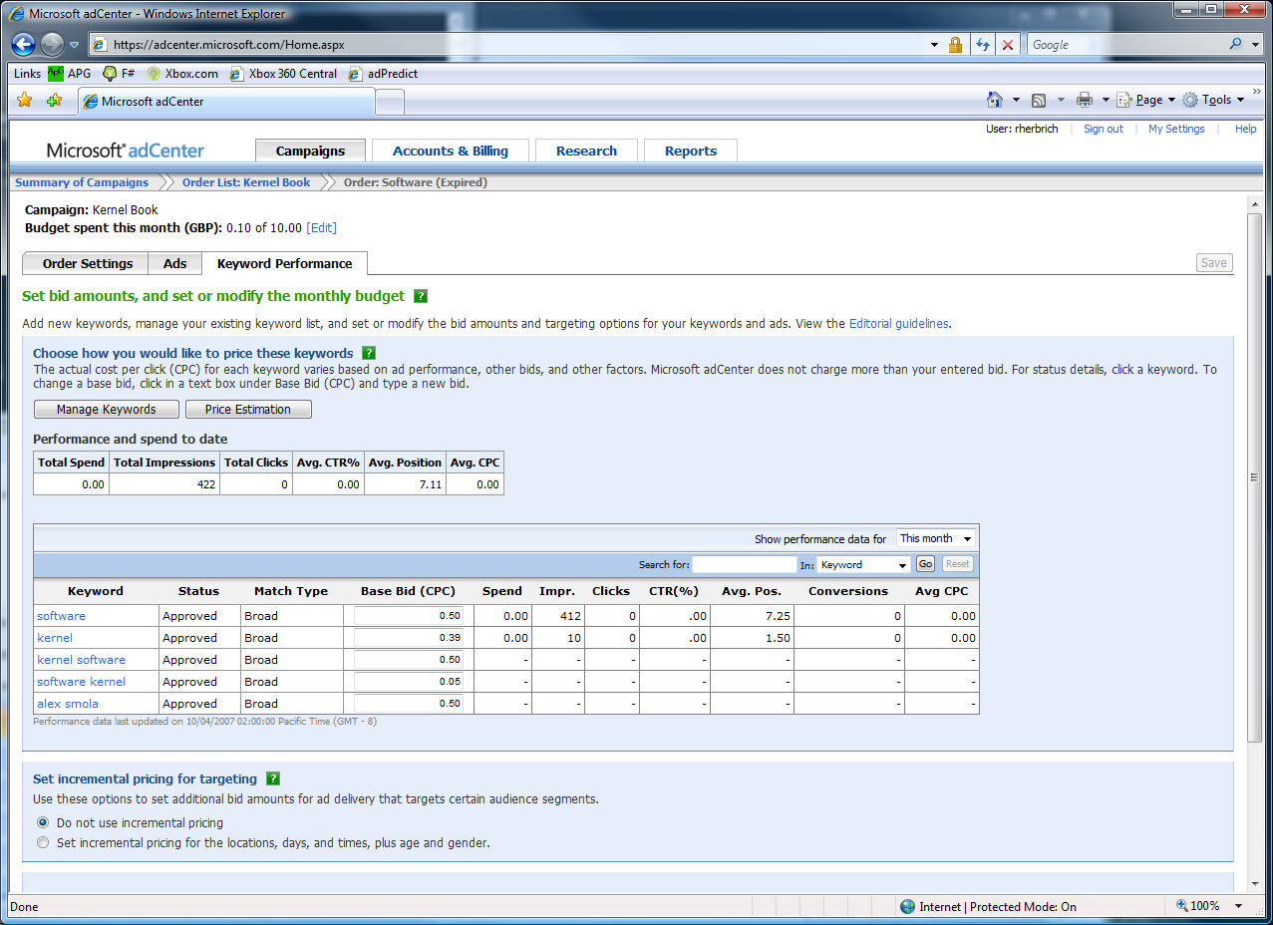

The adCenter Problem
Cash-cow of Search
Selling “web space” at www.live.com and www.msn.com.
“Paid Search” (prices by auctions)
The internal competition focuses on Paid Search.

Slide 34
The Scale of Things
Weeks of data in training:
7,000,000,000 impressions, 6TB data
2 weeks of CPU time during training:
2 wks × 7 days × 86,400 sec/day =
1,209,600 seconds
Learning algorithm speed requirement:
5,787 impression updates / sec
172.8 μs per impression update

Slide 35
F# and adCenter
4 week project, 4 machine learning experts
100million probabilistic variables
Processes 6TB of training data
Real time processing

Slide 36
AdPredict: What We Observed
F#’s powerful type inference means less typing, more thinking
Type-inferred code is easily refactored
Quick Coding
Agile Coding
Scripting
Performance
Memory-Faithful
Succinct
Symbolic
.NET Integration
“Hands-on” exploration.
Immediate scaling to massive data sets
mega-data structures, 16GB machines
Live in the domain, not the language
Schema compilation and “Schedules”
Especially Excel, SQL Server

Slide 37
F# - Concurrent/Reactive/Parallel
Concurrent: Multiple threads of execution
Parallel: These execute simultaneously
Asynchronous: Computations that complete "later"
Reactive: Waiting and responding is normal

Slide 38
Why is it so hard?
To get 50 web pages in parallel?
To get from thread to thread?
To create a worker thread that reads messages?
To handle failure on worker threads?

Slide 39
Why isn’t it this easy?
let ProcessImages() =
Async.Run
(Async.Parallel
[ for i in 1 .. numImages -> ProcessImage(i) ])

Slide 40
Why isn’t it this easy?
let task =
async { ...
do! SwitchToNewThread()
...
do! SwitchToThreadPool()
...
do! SwitchToGuiThread()
.... }

Slide 41
Some Foundation Technologies
.NET/Win32 Threads
System.Threading
.NET Thread Pool
.NET BackgroundWorker and SynchronizationContexts
Parallel Extensions for .NET

Slide 42
F# - Concurrent/Reactive/Parallel
Concurrent: Multiple threads of execution
Parallel: These execute simultaneously
Asynchronous: Computations that complete "later"
Reactive: Waiting and responding is normal

Slide 43
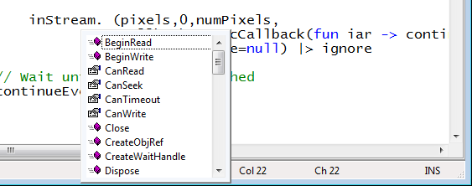
Taming Asynchronous I/O
Target: make it easy to use Begin/End operations
Stream.BeginRead : ...
Stream.EndRead : IAsyncResult * ...

Slide 44
Taming Asynchronous I/O
Typical Control Flow
Compositional
thread-hopping?
BeginRead
EndRead
Rest of Task

Slide 45
Taming Asynchronous I/O
ReadAsync
Rest of Task

Slide 46
Simple Examples
Compute 22 and 7 in parallel
Async.Parallel [ async { -> 2*2 + 3*6 };
async { -> 3 + 5 - 1 } ]
Get these three web pages and wait until all have come back
Async.Parallel [WebRequest.Async "http://www.live.com";
WebRequest.Async "http://www.yahoo.com";
WebRequest.Async "http://www.google.com" ]
let parArrMap f (arr: _[]) =
Async.Run (Async.Parallel [| for x in arr -> async { -> f x } |])
Naive Parallel Array Map

Slide 47
Taming Asynchronous I/O
using System;
using System.IO;
using System.Threading;
public class BulkImageProcAsync
{
public const String ImageBaseName = "tmpImage-";
public const int numImages = 200;
public const int numPixels = 512 * 512;
// ProcessImage has a simple O(N) loop, and you can vary the number
// of times you repeat that loop to make the application more CPU-
// bound or more IO-bound.
public static int processImageRepeats = 20;
// Threads must decrement NumImagesToFinish, and protect
// their access to it through a mutex.
public static int NumImagesToFinish = numImages;
public static Object[] NumImagesMutex = new Object[0];
// WaitObject is signalled when all image processing is done.
public static Object[] WaitObject = new Object[0];
public class ImageStateObject
{
public byte[] pixels;
public int imageNum;
public FileStream fs;
}
public static void ReadInImageCallback(IAsyncResult asyncResult)
{
ImageStateObject state = (ImageStateObject)asyncResult.AsyncState;
Stream stream = state.fs;
int bytesRead = stream.EndRead(asyncResult);
if (bytesRead != numPixels)
throw new Exception(String.Format
("In ReadInImageCallback, got the wrong number of " +
"bytes from the image: {0}.", bytesRead));
ProcessImage(state.pixels, state.imageNum);
stream.Close();
// Now write out the image.
// Using asynchronous I/O here appears not to be best practice.
// It ends up swamping the threadpool, because the threadpool
// threads are blocked on I/O requests that were just queued to
// the threadpool.
FileStream fs = new FileStream(ImageBaseName + state.imageNum +
".done", FileMode.Create, FileAccess.Write, FileShare.None,
4096, false);
fs.Write(state.pixels, 0, numPixels);
fs.Close();
// This application model uses too much memory.
// Releasing memory as soon as possible is a good idea,
// especially global state.
state.pixels = null;
fs = null;
// Record that an image is finished now.
lock (NumImagesMutex)
{
NumImagesToFinish--;
if (NumImagesToFinish == 0)
{
Monitor.Enter(WaitObject);
Monitor.Pulse(WaitObject);
Monitor.Exit(WaitObject);
}
}
}
public static void ProcessImagesInBulk()
{
Console.WriteLine("Processing images... ");
long t0 = Environment.TickCount;
NumImagesToFinish = numImages;
AsyncCallback readImageCallback = new
AsyncCallback(ReadInImageCallback);
for (int i = 0; i < numImages; i++)
{
ImageStateObject state = new ImageStateObject();
state.pixels = new byte[numPixels];
state.imageNum = i;
// Very large items are read only once, so you can make the
// buffer on the FileStream very small to save memory.
FileStream fs = new FileStream(ImageBaseName + i + ".tmp",
FileMode.Open, FileAccess.Read, FileShare.Read, 1, true);
state.fs = fs;
fs.BeginRead(state.pixels, 0, numPixels, readImageCallback,
state);
}
// Determine whether all images are done being processed.
// If not, block until all are finished.
bool mustBlock = false;
lock (NumImagesMutex)
{
if (NumImagesToFinish > 0)
mustBlock = true;
}
if (mustBlock)
{
Console.WriteLine("All worker threads are queued. " +
" Blocking until they complete. numLeft: {0}",
NumImagesToFinish);
Monitor.Enter(WaitObject);
Monitor.Wait(WaitObject);
Monitor.Exit(WaitObject);
}
long t1 = Environment.TickCount;
Console.WriteLine("Total time processing images: {0}ms",
(t1 - t0));
}
}
let ProcessImageAsync () =
async { let inStream = File.OpenRead(sprintf "Image%d.tmp" i)
let! pixels = inStream.ReadAsync(numPixels)
let pixels' = TransformImage(pixels,i)
let outStream = File.OpenWrite(sprintf "Image%d.done" i)
do! outStream.WriteAsync(pixels')
do Console.WriteLine "done!" }
let ProcessImagesAsyncWorkflow() =
Async.Run (Async.Parallel
[ for i in 1 .. numImages -> ProcessImageAsync i ])
Processing 200 images in parallel

Slide 48
8 Ways to Learn
FSI.exe
Samples Included
Go to definition
Lutz’ Reflector
http://cs.hubfs.net
Codeplex Fsharp Samples
Books
ML

Slide 49
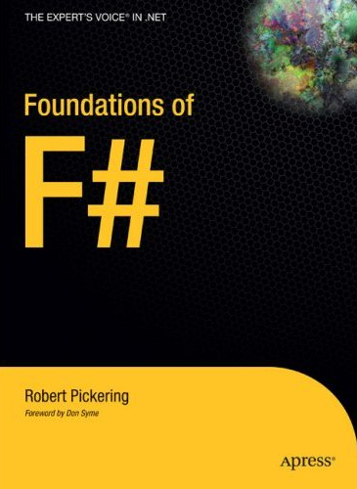
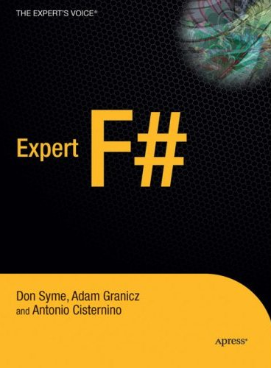

Books about F#
Visit http://research.microsoft.com/fsharp
http://blogs.msdn.com/dsyme

Slide 50
Getting F#
“Spring Refresh” just released (1.9.4)
Focus on Simplicity, Regularity, Correctness
CTP: Late Summer
And then onwards towards “Visual Studio Next”

Slide 51
Questions & Discussion

Slide 52



© 2007 Microsoft Corporation. All rights reserved. This presentation is for informational purposes only. MICROSOFT MAKES NO WARRANTIES, EXPRESS OR IMPLIED, IN THIS SUMMARY.

